Slide 1


A
Project On
“Gold Price Prediction”
Presented By:- Group No: 28
Sravani Alla (210541283052)
Patil Deepshri (210541283036)
Under Guidance of
Mr. Akshay Tilekar
e- DBDA May 2021
Institute for Advance Computing and Software Development Akurdi, Pune. 411044

Slide 2
Contents
Introduction
Objectives
Problem Statement
Working Method
Experimental Analysis
Conclusion

Slide 3
Introduction
Historically, gold has been identified as a unique commodity because of its ability to act as a hedge against inflation and its stability during periods of financial volatility and crises.
Time series analysis is a popular forecasting method for predicting the future value of variables.
This technique also uses historical data to predict the future value of a variable.
ARIMA (Autoregressive Integrated Moving Average) model has been used in this project for Gold price forecasting.

Slide 4
Objectives
GOLD ETF price forecasting, trends and 1 year predictions.
The goal of this project is to understand and apply time-series models like ARIMA, SARIMA in forecasting the price of gold ETF.

Slide 5
Problem Statement
Many investors buy gold as a safe haven to protect themselves against a possible catastrophe , profit from these tremendous increases in the price of gold and protect themselves against inflation.
Gold has historically been as an asset that booms in a recession because unlike fiat currencies such as the Dollar, Yen and the Pound, it has inherent value as a commodity currency.
Is gold a good commodity to buy now for later profits?

Slide 6
Working Method
A time series is a series of data points indexed (or listed or graphed) in time order. Most commonly, a time series is a sequence taken at successive equally spaced points in time.
Thus it is a sequence of discrete-time data. Examples include daily closing price of S&P Index, daily average temperate etc. Time Series are analyzed to determine the long term trend so as to forecast the future or perform some other form of analysis.

Slide 7
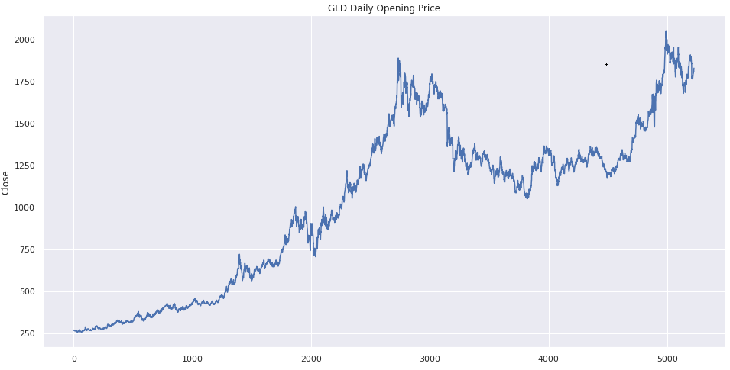
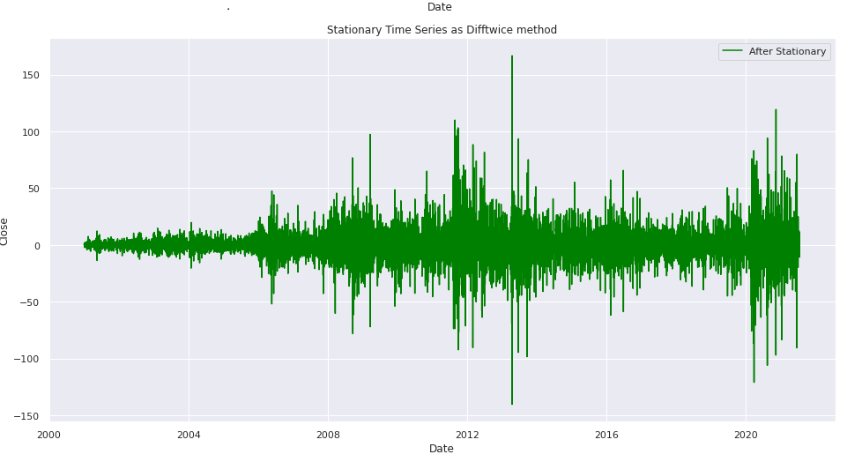
Data Visualization

Slide 8
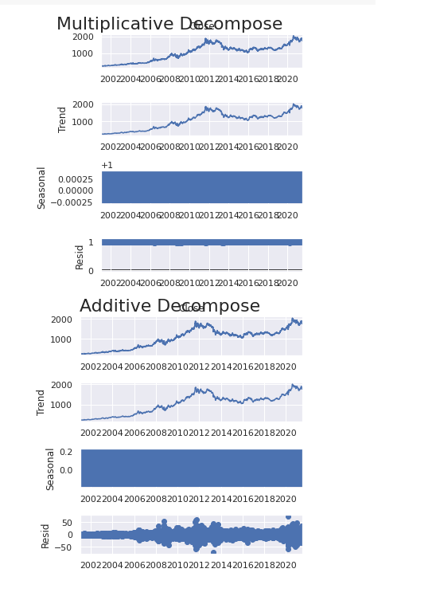
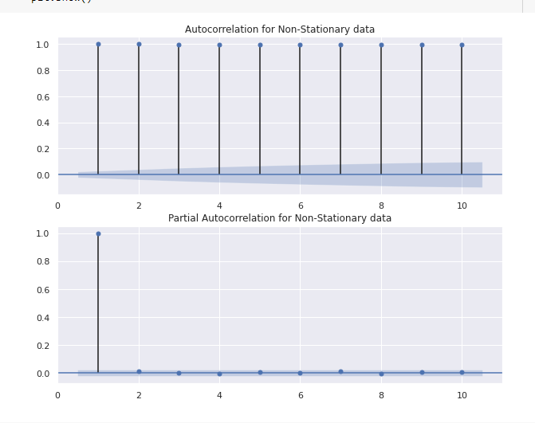

Slide 9
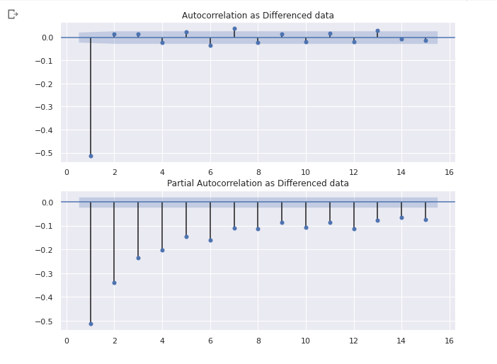
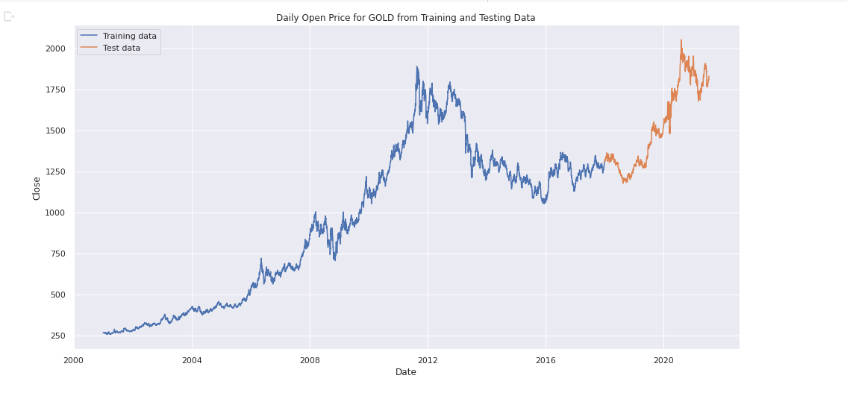

Slide 10
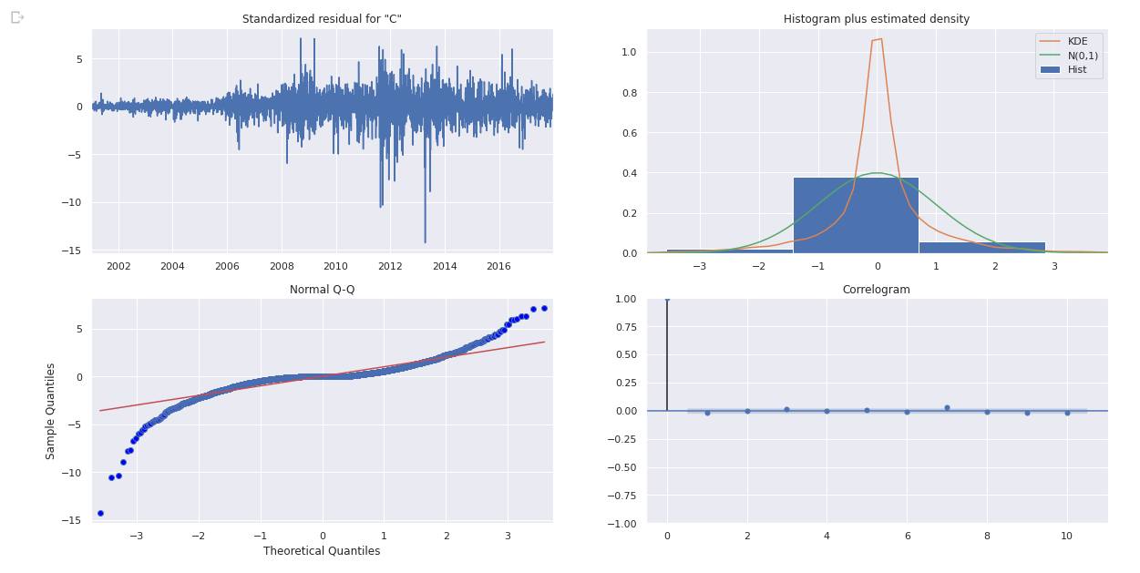

Slide 11
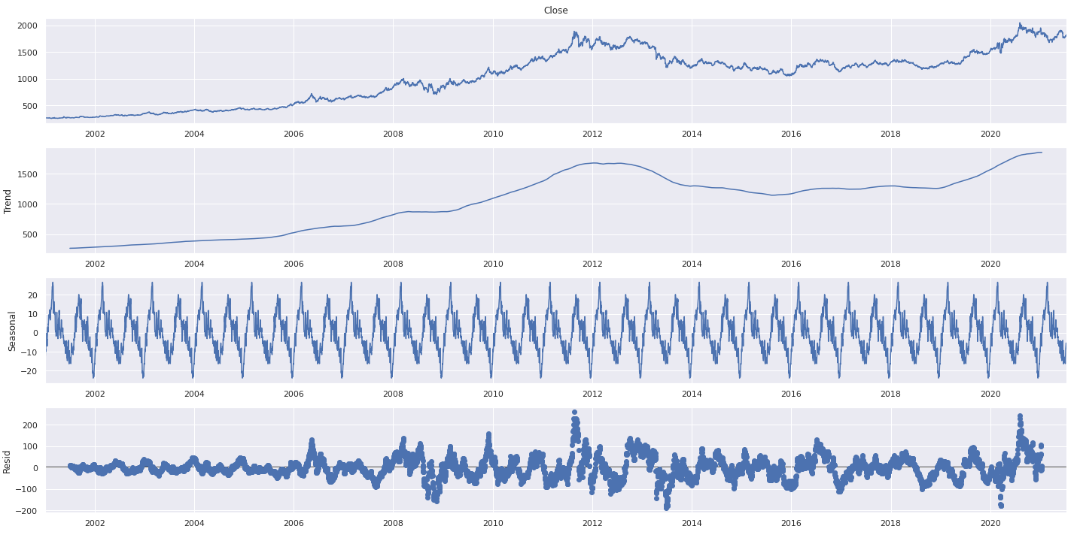

Slide 12
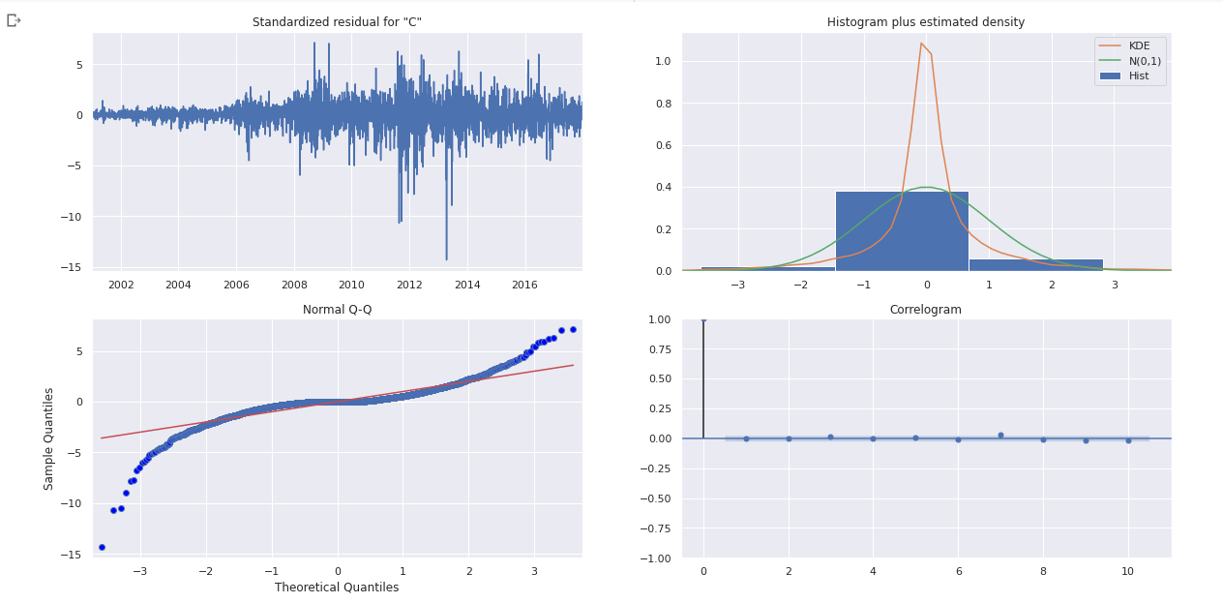

Slide 13
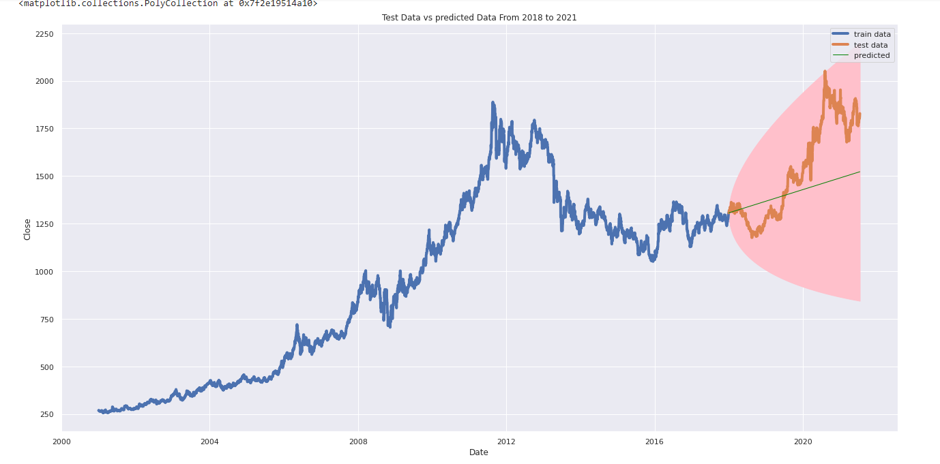

Slide 14
Conclusion
Between ARIMA and SARIMA.
In the out-of-sample forecast, the SARIMA model shows an upward trend in gold prices for the next 1 year.

Slide 15
Thank You!

